Slide 1
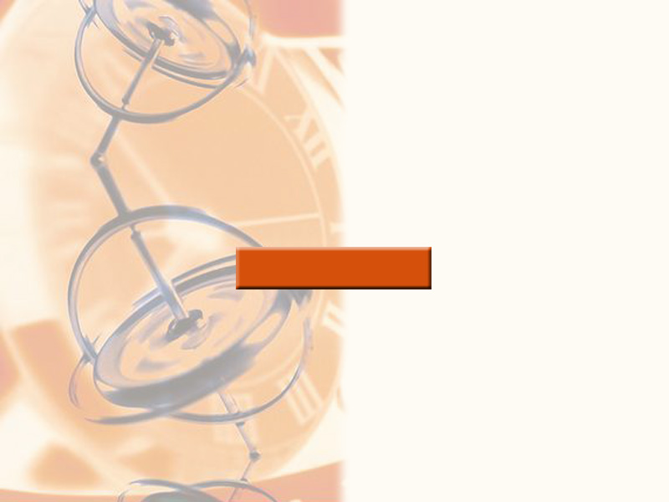
5
INTEGRALS

Slide 2
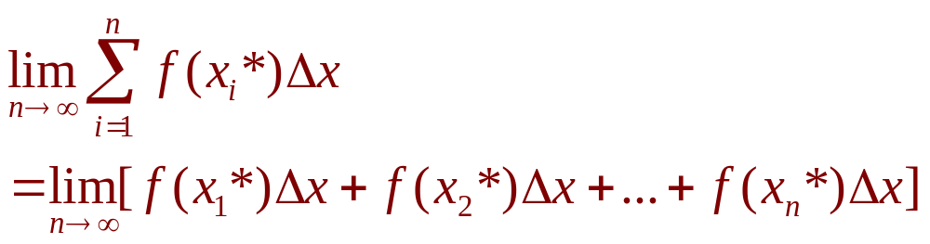
INTEGRALS
Equation 1
We saw in Section 5.1 that a limit of the form
arises when we compute an area.
  We also saw that it arises when we try to find
  the distance traveled by an object.

Slide 3
INTEGRALS
It turns out that this same type of limit occurs in a wide variety of situations
even when f is not necessarily a positive function.

Slide 4
INTEGRALS
In Chapters 6 and 8, we will see that
limits of the form Equation 1 also arise
in finding:
  Lengths of curves
  Volumes of solids
  Centers of mass
  Force due to water pressure
  Work

Slide 5
INTEGRALS
Therefore, we give this
type of limit a special name
and notation.

Slide 6
INTEGRALS
5.2
The Definite Integral
In this section, we will learn about:
Integrals with limits that represent
a definite quantity.
Notes:
CHECK LATER.

Slide 7
DEFINITE INTEGRAL
Definition 2
If f is a function defined for a ≤ x ≤ b,
we divide the interval [a, b] into n subintervals of equal width ∆x = (b – a)/n.
  We let x₀(= a), x₁, x₂, …, x_{n}(= b) be the endpoints
  of these subintervals.
  We let x₁*, x₂*,…., x_{n}* be any sample points in
  these subintervals, so x_{i}* lies in the i th subinterval.

Slide 8
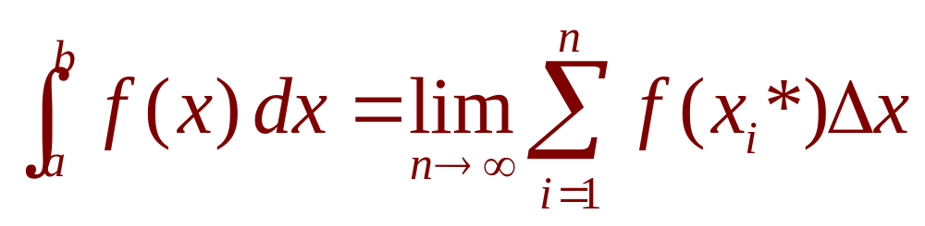
DEFINITE INTEGRAL
Definition 2
Then, the definite integral of f from a to b is
provided that this limit exists.
If it does exist, we say f is integrable on [a, b].

Slide 9
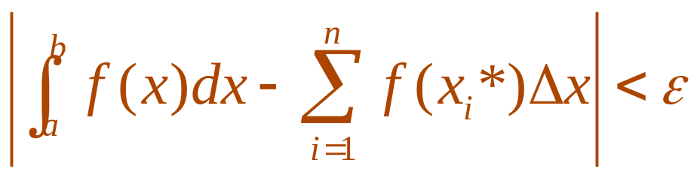
DEFINITE INTEGRAL
The precise meaning of the limit that defines the integral is as follows:
  For every number ε > 0 there is an integer N
  such that
  for every integer n > N and for every choice
  of x_{i}* in [x_{i-1}, x_{i}].

Slide 10
INTEGRAL SIGN
Note 1
The symbol ∫ was introduced by Leibniz and is called an integral sign.
  It is an elongated S.
  It was chosen because an integral is
  a limit of sums.

Slide 11
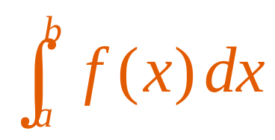
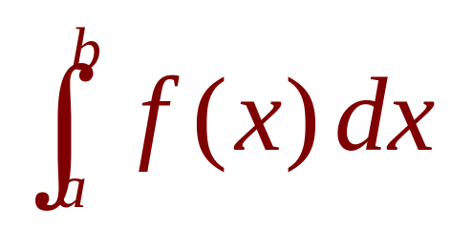
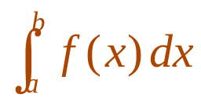
NOTATION
Note 1
In the notation ,
  f(x) is called the integrand.
  a and b are called the limits of integration;
  a is the lower limit and b is the upper limit.
  For now, the symbol dx has no meaning by itself; is all one symbol. The dx simply indicates
  that the independent variable is x.

Slide 12
INTEGRATION
Note 1
The procedure of
calculating an integral
is called integration.

Slide 13
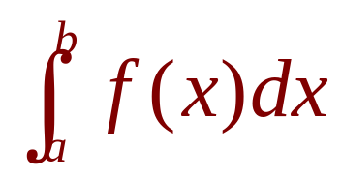
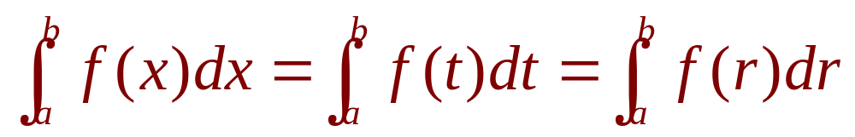
DEFINITE INTEGRAL
Note 2
The definite integral is a number.
It does not depend on x.
In fact, we could use any letter in place of x without changing the value of the integral:

Slide 14
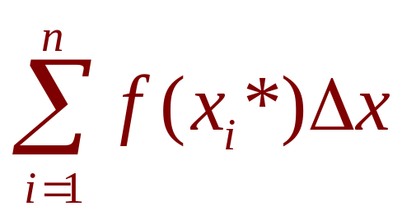
RIEMANN SUM
Note 3
The sum
that occurs in Definition 2 is called
a Riemann sum.
  It is named after the German mathematician Bernhard Riemann (1826–1866).

Slide 15
RIEMANN SUM
Note 3
So, Definition 2 says that the definite integral of an integrable function can be approximated to within any desired degree of accuracy by
a Riemann sum.

Slide 16
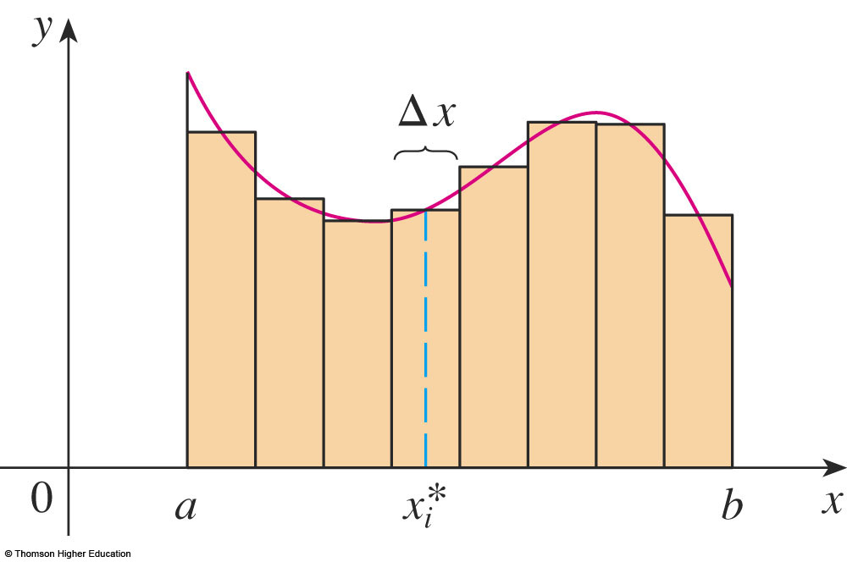
RIEMANN SUM
Note 3
We know that, if f happens to be positive,
the Riemann sum can be interpreted as:
  A sum of areas of approximating rectangles

Slide 17

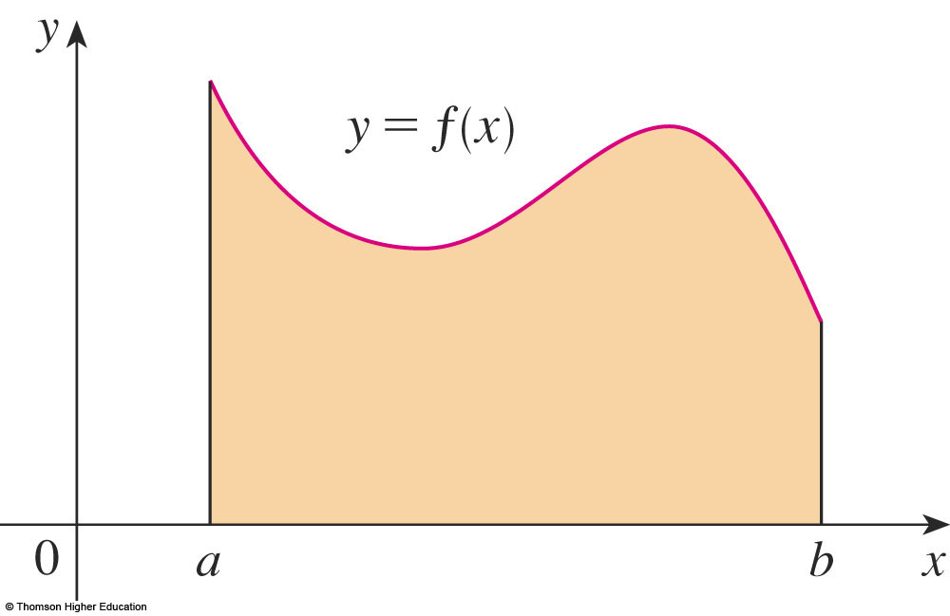
RIEMANN SUM
Note 3
Comparing Definition 2 with the definition
of area in Section 5.1, we see that the definite integral can be interpreted as:
  The area under the curve y = f(x) from a to b

Slide 18
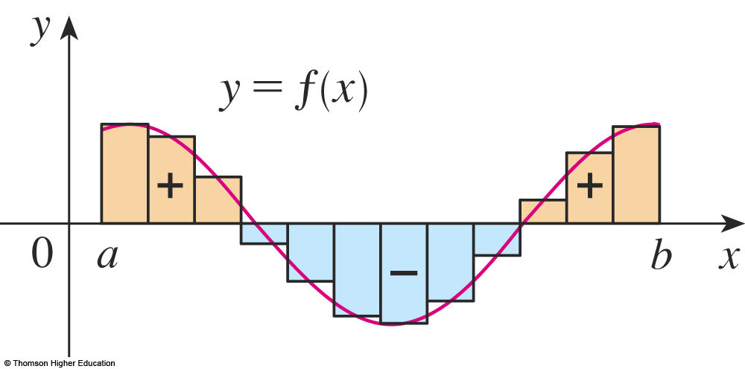
RIEMANN SUM
Note 3
If f takes on both positive and negative values, then the Riemann sum is:
  The sum of the areas of the rectangles that lie
  above the x-axis and the negatives of the areas
  of the rectangles that lie below the x-axis
  That is, the areas of
  the gold rectangles
  minus the areas of
  the blue rectangles

Slide 19
RIEMANN SUM
Note 3
When we take the limit of such
Riemann sums, we get the situation illustrated here.

Slide 20
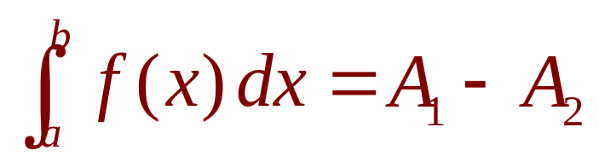
NET AREA
Note 3
A definite integral can be interpreted as
a net area, that is, a difference of areas:
  A₁ is the area of the region
  above the x-axis and below the graph of f.
  A₂ is the area
  of the region
  below the
  x-axis and
  above the
  graph of f.

Slide 21

UNEQUAL SUBINTERVALS
Note 4
Though we have defined by dividing
[a, b] into subintervals of equal width, there are situations in which it is advantageous
to work with subintervals of unequal width.
  In Exercise 14 in Section 5.1, NASA provided velocity data at times that were not equally spaced.
  We were still able to estimate the distance traveled.

Slide 22
UNEQUAL SUBINTERVALS
Note 4
There are methods for numerical integration that take advantage of unequal subintervals.

Slide 23
UNEQUAL SUBINTERVALS
Note 4
If the subinterval widths are ∆x₁, ∆x₂, …, ∆x_{n}, we have to ensure that all these widths approach 0 in the limiting process.
  This happens if the largest width, max ∆x_{i} , approaches 0.

Slide 24
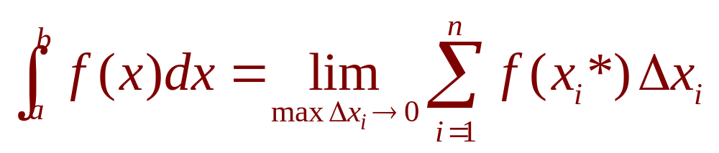
UNEQUAL SUBINTERVALS
Note 4
Thus, in this case, the definition of
a definite integral becomes:

Slide 25
INTEGRABLE FUNCTIONS
Note 5
We have defined the definite integral
for an integrable function.
However, not all functions are integrable.

Slide 26
INTEGRABLE FUNCTIONS
The following theorem shows that
the most commonly occurring functions
are, in fact, integrable.
  It is proved in more advanced courses.

Slide 27
INTEGRABLE FUNCTIONS
Theorem 3
If f is continuous on [a, b], or if f has only
a finite number of jump discontinuities, then
f is integrable on [a, b].
That is, the definite integral exists.

Slide 28
INTEGRABLE FUNCTIONS
If f is integrable on [a, b], then the limit
in Definition 2 exists and gives the same value, no matter how we choose the sample points x_{i}*.

Slide 29
INTEGRABLE FUNCTIONS
To simplify the calculation of the integral, we often take the sample points to be right endpoints.
  Then, x_{i}* = x_{i} and the definition of an integral simplifies as follows.

Slide 30
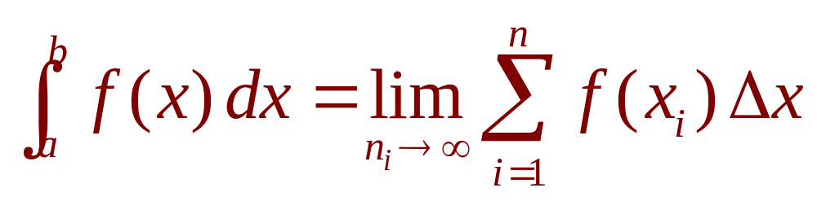
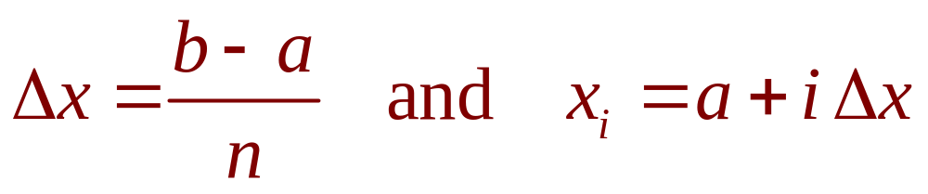
INTEGRABLE FUNCTIONS
Theorem 4
If f is integrable on [a, b], then
where

Slide 31
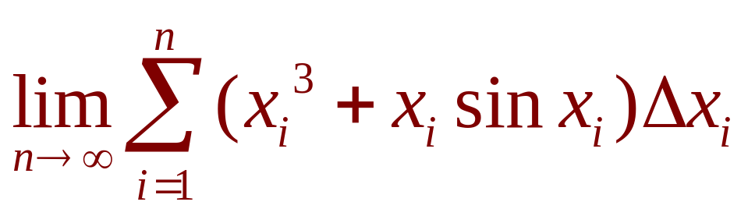
DEFINITE INTEGRAL
Example 1
Express
as an integral on the interval [0, π].
  Comparing the given limit with the limit
  in Theorem 4, we see that they will be
  identical if we choose f(x) = x³ + x sin x.

Slide 32
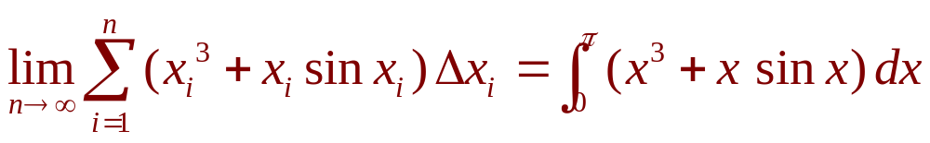
DEFINITE INTEGRAL
Example 1
We are given that a = 0 and b = π.
So, by Theorem 4, we have:

Slide 33
DEFINITE INTEGRAL
Later, when we apply the definite integral to physical situations, it will be important to recognize limits of sums as integrals—as we did in Example 1.

Slide 34
DEFINITE INTEGRAL
When Leibniz chose the notation for
an integral, he chose the ingredients
as reminders of the limiting process.

Slide 35
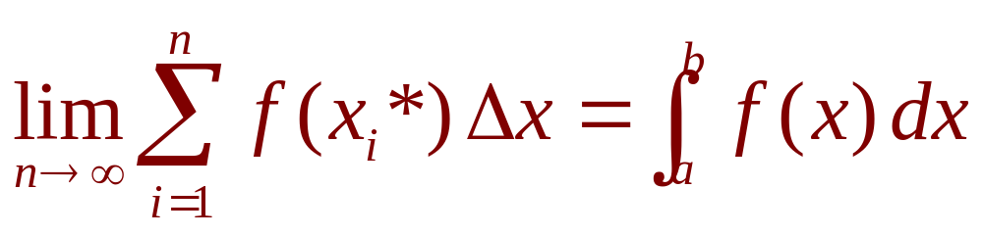
DEFINITE INTEGRAL
In general, when we write
we replace:
  lim Σ by ∫
  x_{i}* by x
  ∆x by dx

Slide 36
EVALUATING INTEGRALS
When we use a limit to evaluate
a definite integral, we need to know
how to work with sums.

Slide 37
EVALUATING INTEGRALS
The following three equations
give formulas for sums of powers
of positive integers.

Slide 38
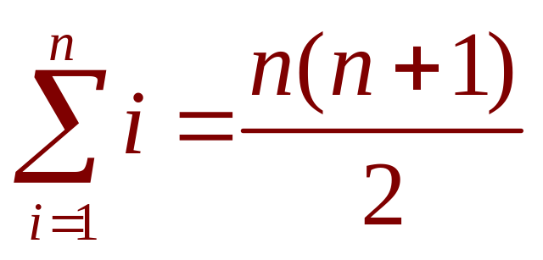
EVALUATING INTEGRALS
Equation 5
Equation 5 may be familiar to you
from a course in algebra.

Slide 39
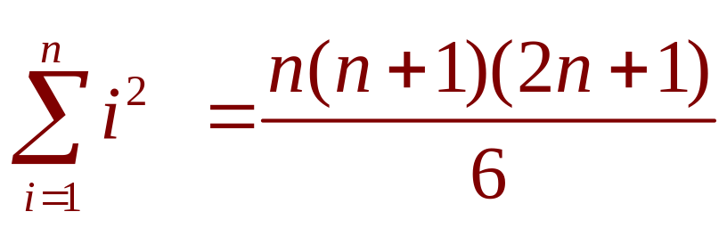
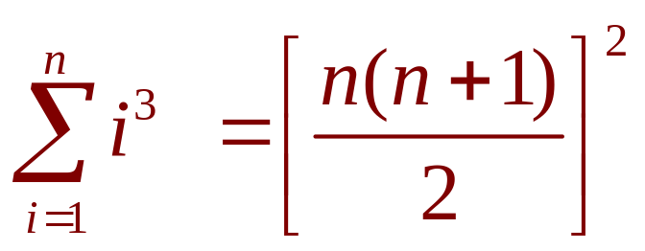
EVALUATING INTEGRALS
Equations 6 & 7
Equations 6 and 7 were discussed in
Section 5.1 and are proved in Appendix E.

Slide 40
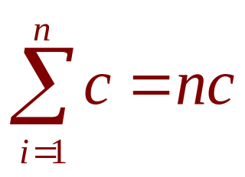
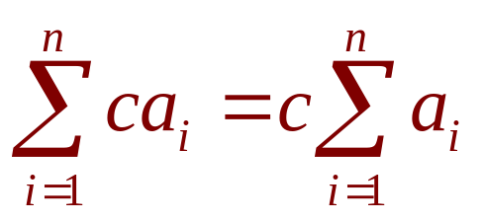
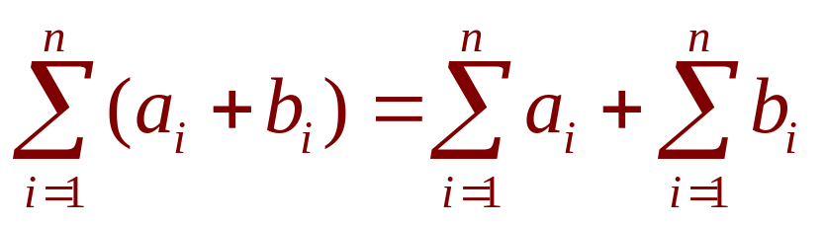
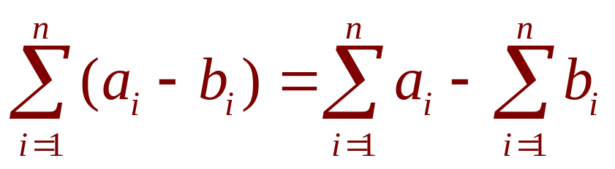
EVALUATING INTEGRALS
Eqns. 8, 9, 10 & 11
The remaining formulas are simple rules for working with sigma notation:

Slide 41
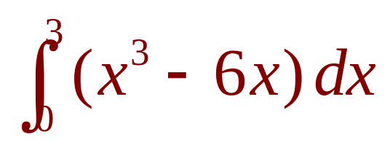
EVALUATING INTEGRALS
Example 2
Evaluate the Riemann sum for f(x) = x³ – 6x taking the sample points to be right endpoints and a = 0, b = 3, and n = 6.
Evaluate .

Slide 42
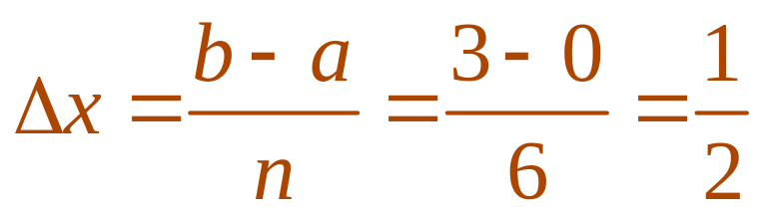
EVALUATING INTEGRALS
Example 2 a
With n = 6,
  The interval width is:
  The right endpoints are:
  x₁ = 0.5, x₂ = 1.0, x₃ = 1.5,
  x₄ = 2.0, x₅ = 2.5, x₆ = 3.0

Slide 43
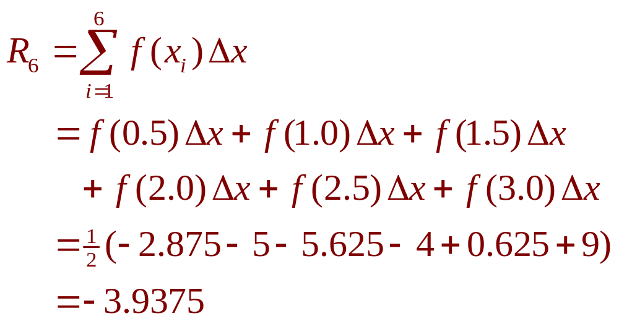
EVALUATING INTEGRALS
Example 2 a
So, the Riemann sum is:

Slide 44
EVALUATING INTEGRALS
Example 2 a
Notice that f is not a positive function.
So, the Riemann sum does not
represent a sum of areas of rectangles.

Slide 45
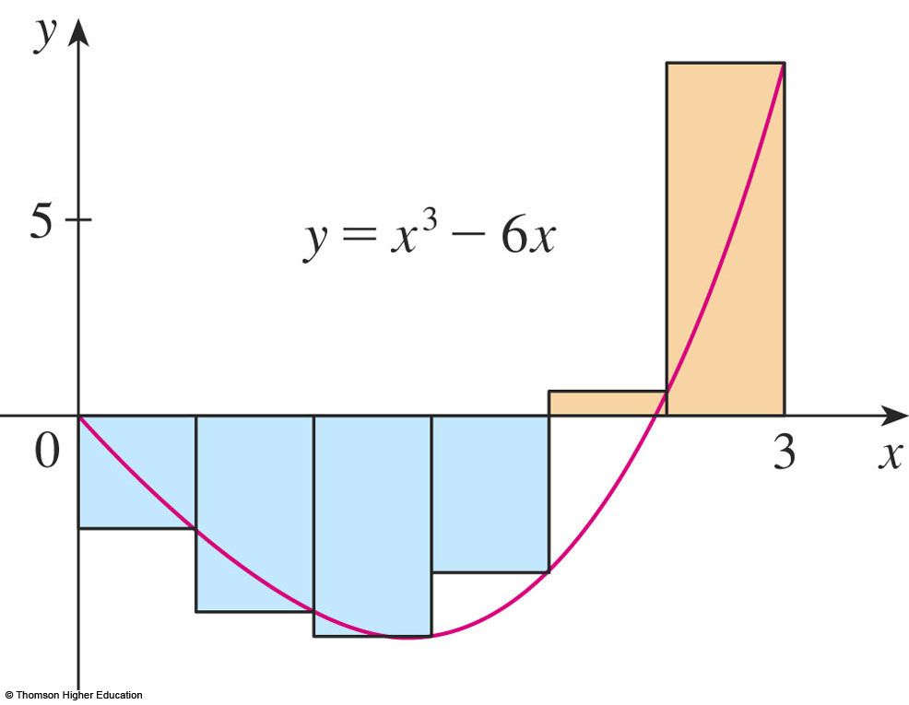
EVALUATING INTEGRALS
Example 2 a
However, it does represent the sum of the areas of the gold rectangles (above the x-axis) minus the sum of the areas of the blue rectangles (below the x-axis).

Slide 46
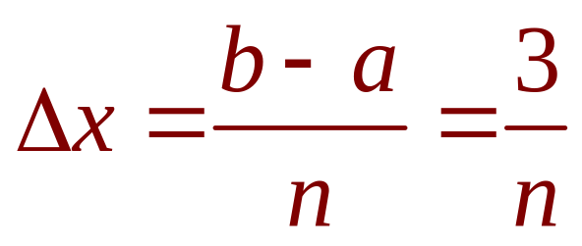
EVALUATING INTEGRALS
Example 2 b
With n subintervals, we have:
Thus, x₀ = 0, x₁ = 3/n, x₂ = 6/n, x₃ = 9/n.
In general, x_{i} = 3i/n.

Slide 47
EVALUATING INTEGRALS
Example 2 b
Since we are using right
endpoints, we can use Theorem 4, as follows.

Slide 48
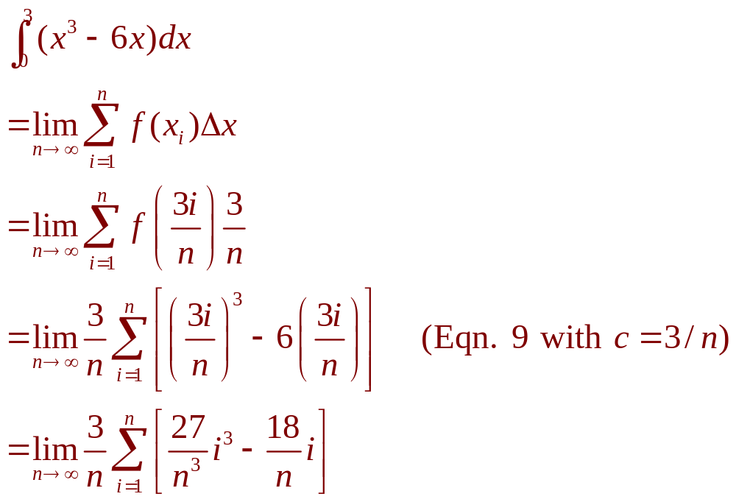
EVALUATING INTEGRALS
Example 2 b

Slide 49
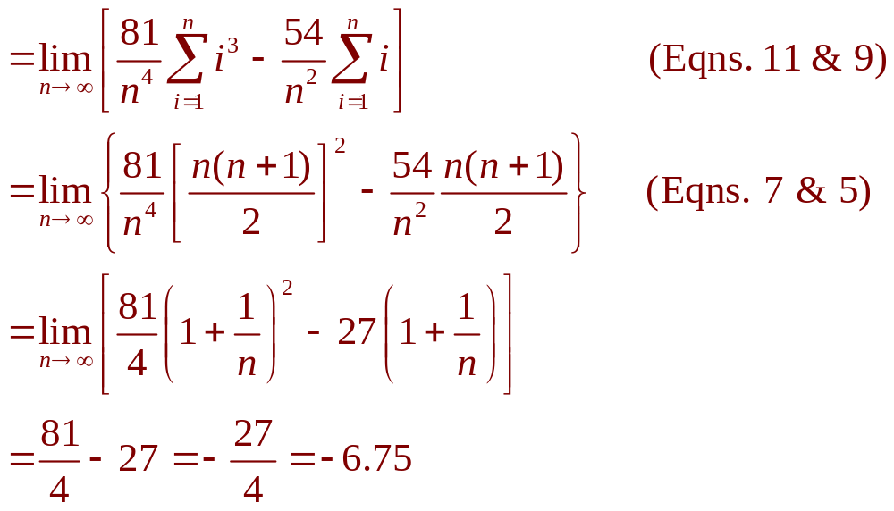
EVALUATING INTEGRALS
Example 2 b

Slide 50
EVALUATING INTEGRALS
Example 2 b
This integral can’t be interpreted as
an area because f takes on both positive and negative values.

Slide 51
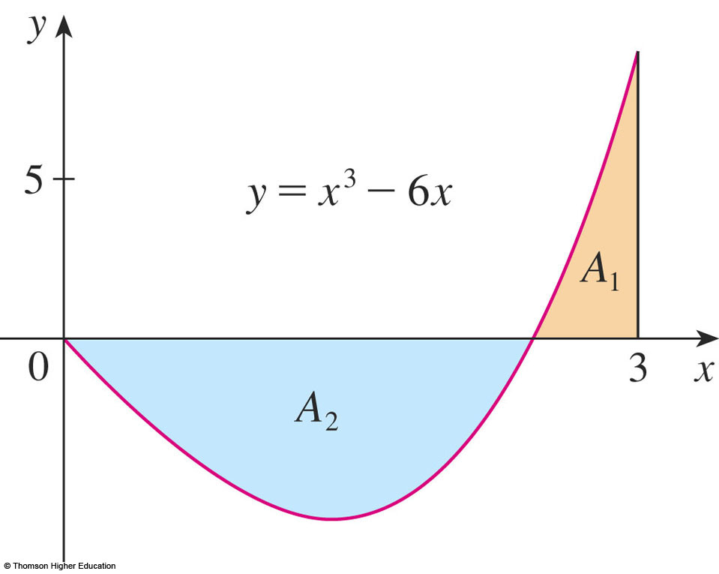
EVALUATING INTEGRALS
Example 2 b
However, it can be interpreted as
the difference of areas A₁ – A₂, where
A₁ and A₂ are as shown.

Slide 52
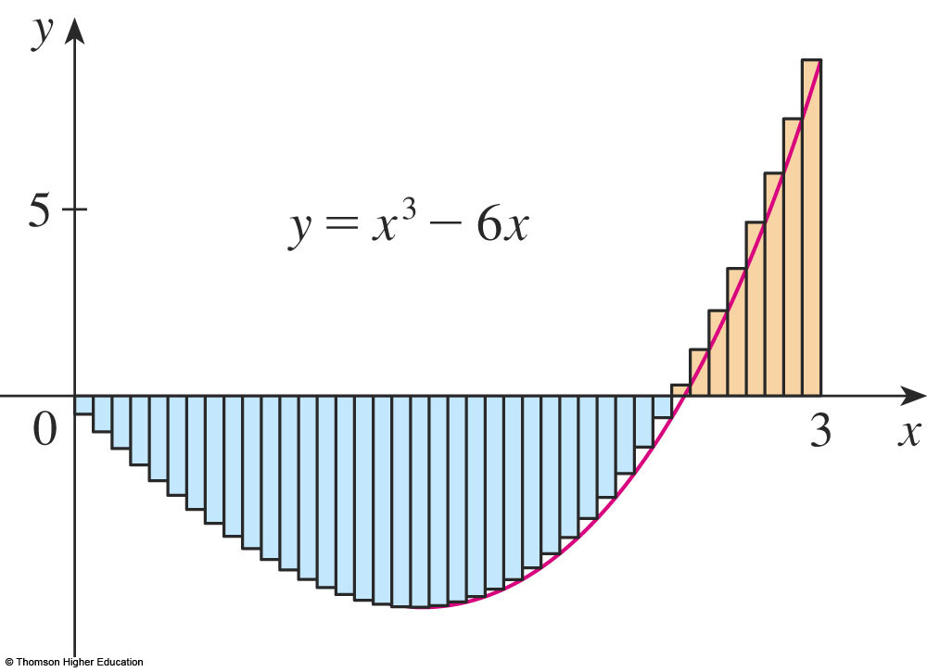
EVALUATING INTEGRALS
Example 2 b
This figure illustrates the calculation by showing the positive and negative terms
in the right Riemann sum R_{n} for n = 40.

Slide 53
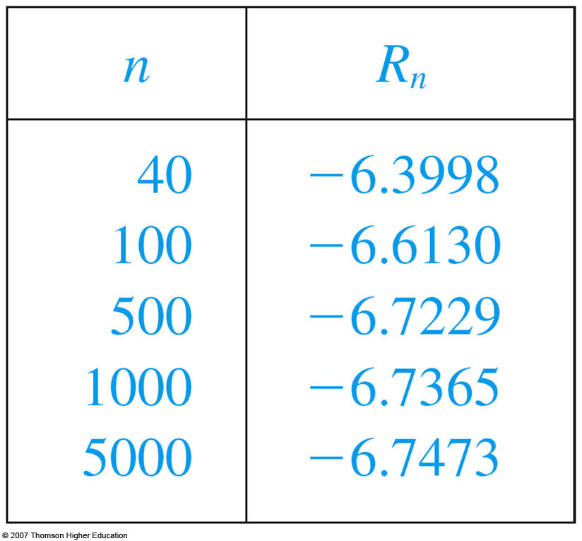
EVALUATING INTEGRALS
Example 2 b
The values in the table show the Riemann sums approaching the exact value of
the integral, -6.75, n → ∞.

Slide 54
EVALUATING INTEGRALS
A much simpler method for
evaluating the integral in Example 2
will be given in Section 5.3

Slide 55
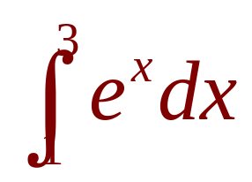
EVALUATING INTEGRALS
Example 3
Set up an expression for as
a limit of sums.
Use a computer algebra system (CAS)
to evaluate the expression.

Slide 56
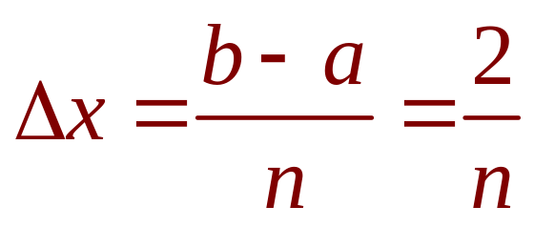
EVALUATING INTEGRALS
Example 3 a
Here, we have f(x) = e^{x}, a = 1, b = 3,
and
So, x₀ = 1, x₁ = 1 + 2/n, x₂ = 1 + 4/n,
x₃ = 1 + 6/n, and
x_{i} = 1 + 2i / n

Slide 57
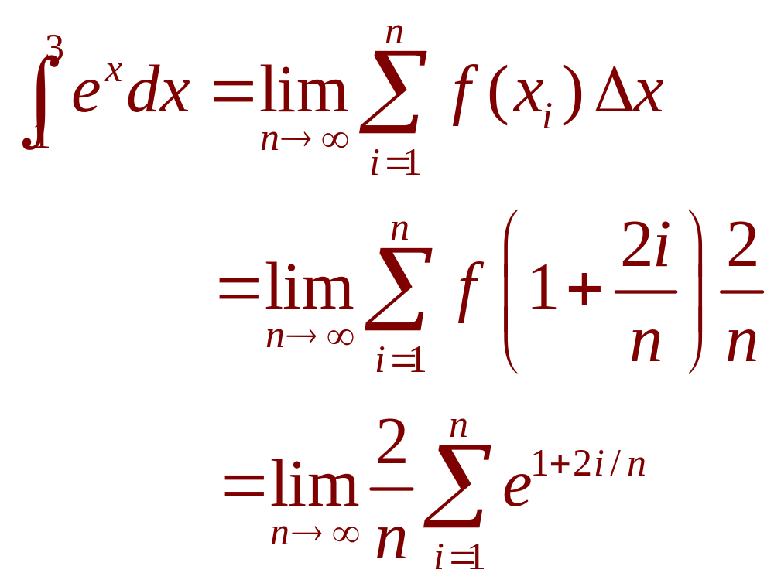
EVALUATING INTEGRALS
Example 3 a
From Theorem 4, we get:

Slide 58
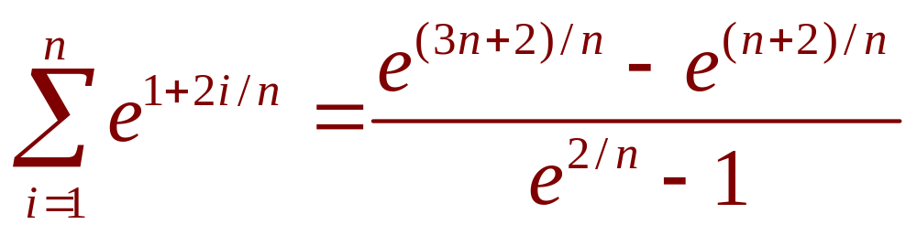
EVALUATING INTEGRALS
Example 3 b
If we ask a CAS to evaluate the sum
and simplify, we obtain:

Slide 59
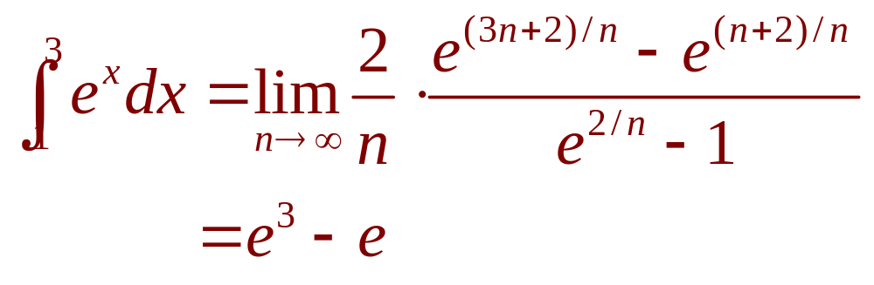
EVALUATING INTEGRALS
Example 3 b
Now, we ask the CAS to evaluate
the limit:

Slide 60
EVALUATING INTEGRALS
Example 3 b
We will learn a much easier
method for the evaluation of integrals
in the next section.

Slide 61
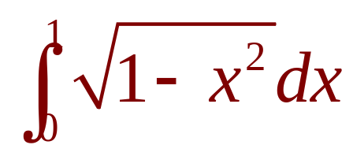
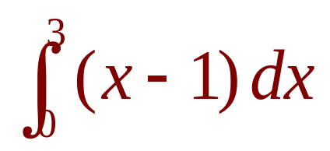
EVALUATING INTEGRALS
Example 4
Evaluate the following integrals by interpreting each in terms of areas.
a.
b.

Slide 62
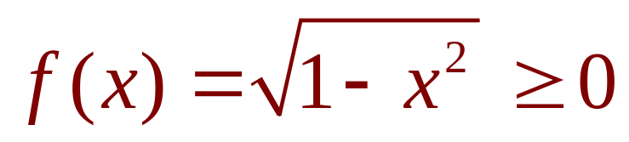
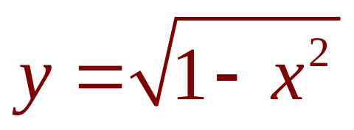
EVALUATING INTEGRALS
Example 4 a
Since ,
we can interpret this integral as
the area under the curve
from 0 to 1.

Slide 63
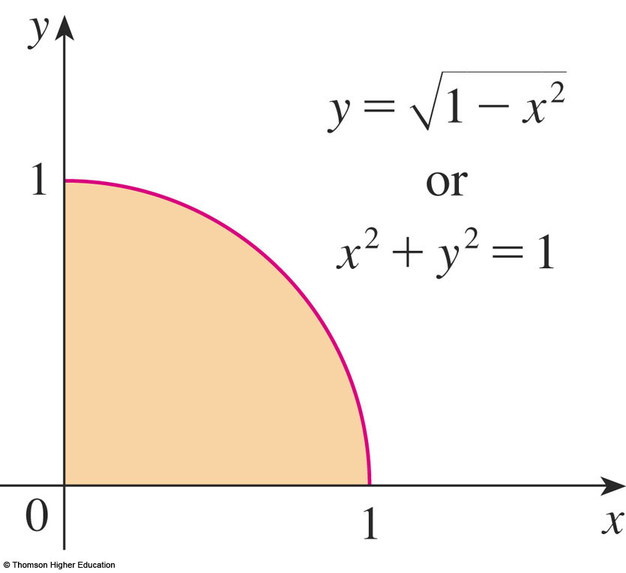
EVALUATING INTEGRALS
Example 4 a
However, since y² = 1 - x², we get:
x² + y² = 1
  This shows that
  the graph of f is
  the quarter-circle
  with radius 1.

Slide 64
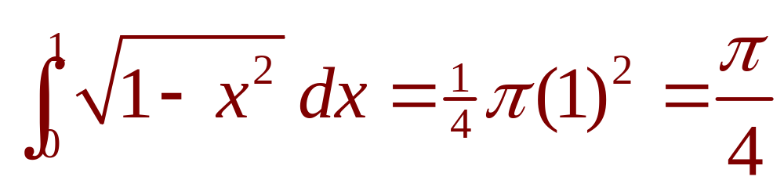
EVALUATING INTEGRALS
Example 4 a
Therefore,
  In Section 7.3, we will be able to prove that
  the area of a circle of radius r is πr².

Slide 65
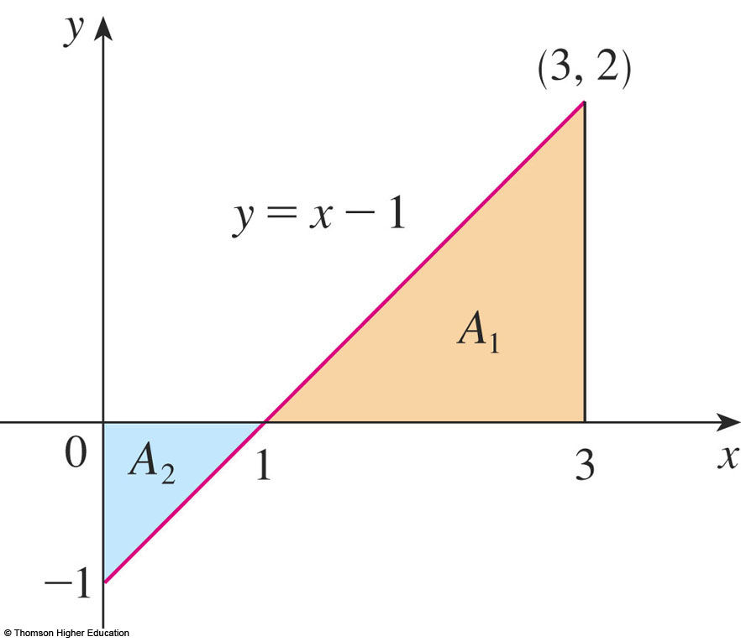
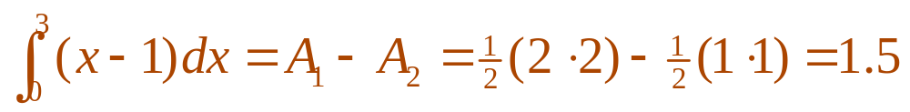
EVALUATING INTEGRALS
Example 4 b
The graph of y = x – 1
is the line with slope 1
shown here.
  We compute the integral
  as the difference of the
  areas of the two triangles:

Slide 66
MIDPOINT RULE
We often choose the sample point x_{i}*
to be the right endpoint of the i th subinterval because it is convenient for computing
the limit.

Slide 67

MIDPOINT RULE
However, if the purpose is to find
an approximation to an integral, it is usually
better to choose x_{i}* to be the midpoint of
the interval.
  We denote this by .

Slide 68
MIDPOINT RULE
Any Riemann sum is an approximation
to an integral.
However, if we use midpoints, we get
the following approximation.

Slide 69

THE MIDPOINT RULE

Slide 70

MIDPOINT RULE
Example 5
Use the Midpoint Rule with n = 5
to approximate
  The endpoints of the five subintervals
  are: 1, 1.2, 1.4, 1.6, 1.8, 2.0
  So, the midpoints are: 1.1, 1.3, 1.5, 1.7, 1.9

Slide 71

MIDPOINT RULE
Example 5
  The width of the subintervals is:
  ∆x = (2 - 1)/5 = 1/5
  So, the Midpoint Rule gives:

Slide 72

MIDPOINT RULE
Example 5
As f(x) = 1/x for 1 ≤ x ≤ 2, the integral represents an area, and the approximation given by the rule is the sum of the areas of
the rectangles shown.

Slide 73
MIDPOINT RULE
At the moment, we don’t know
how accurate the approximation in
Example 5 is.
  However, in Section 7.7, we will learn a method
  for estimating the error involved in using the rule.
  At that time, we will discuss other methods
  for approximating definite integrals.

Slide 74

MIDPOINT RULE
If we apply the rule to the integral in Example 2, we get this picture.

Slide 75

MIDPOINT RULE
The approximation
M₄₀ = -6.7563
is much closer to
the true value -6.75 than the right endpoint approximation,
R₄₀ = -6.3998,
in the earlier figure.

Slide 76

PROPERTIES OF DEFINITE INTEGRAL
When we defined the definite integral
, we implicitly assumed that a < b.
However, the definition as a limit of Riemann sums makes sense even if a > b.

Slide 77


PROPERTIES OF DEFINITE INTEGRAL
Notice that, if we reverse a and b, then ∆x changes from (b – a)/n to (a – b)/n.
Therefore,
If a = b, then ∆x = 0, and so

Slide 78
PROPERTIES OF INTEGRALS
We now develop some basic
properties of integrals that will
help us evaluate integrals in a simple manner.

Slide 79

PROPERTIES OF THE INTEGRAL
We assume f and g are continuous functions.

Slide 80

PROPERTY 1
Property 1 says that the integral of a constant function f(x) = c is the constant times the length of the interval.

Slide 81

PROPERTY 1
If c > 0 and a < b, this is to be expected, because c(b – a) is the area of the shaded rectangle here.

Slide 82

PROPERTY 2
Property 2 says that the integral of a sum
is the sum of the integrals.

Slide 83
PROPERTY 2
For positive functions, it says that
the area under f + g is the area under
f plus the area under g.

Slide 84

PROPERTY 2
The figure helps us understand why
this is true.
  In view of how graphical
  addition works,
  the corresponding
  vertical line segments
  have equal height.

Slide 85

PROPERTY 2
In general, Property 2 follows from Theorem 4 and the fact that the limit of a sum is the sum of the limits:

Slide 86

PROPERTY 3
Property 3 can be proved in a similar manner and says that the integral of a constant times
a function is the constant times the integral
of the function.
  That is, a constant (but only a constant) can be taken
  in front of an integral sign.

Slide 87

PROPERTY 4
Property 4 is proved by writing f – g = f + (-g) and using Properties 2 and 3 with c = -1.

Slide 88


PROPERTIES OF INTEGRALS
Example 6
Use the properties of integrals to evaluate
  Using Properties 2 and 3 of integrals,
  we have:

Slide 89


PROPERTIES OF INTEGRALS
Example 6
  We know from Property 1 that:
  We found in Example 2 in Section 5.1
  that:

Slide 90

PROPERTIES OF INTEGRALS
Example 6
  Thus,

Slide 91

PROPERTY 5
Property 5 tells us how to combine
integrals of the same function over
adjacent intervals:

Slide 92
PROPERTY 5
In general, Property 5 is
not easy to prove.

Slide 93

PROPERTY 5
However, for the case where f(x) ≥ 0 and
a < c < b, it can be seen from the geometric interpretation in the figure.
  The area under y = f(x)
  from a to c plus
  the area from c to b
  is equal to the total area
  from a to b.

Slide 94


PROPERTIES OF INTEGRALS
Example 7
If it is known that
find:

Slide 95


PROPERTIES OF INTEGRALS
Example 7
By Property 5, we have:
So,

Slide 96
PROPERTIES OF INTEGRALS
Properties 1–5 are true
whether:
  a < b
  a = b
  a > b

Slide 97

COMPARISON PROPERTIES OF THE INTEGRAL
These properties, in which we compare sizes of functions and sizes of integrals, are true only if a ≤ b.

Slide 98


PROPERTY 6
If f(x) ≥ 0, then represents
the area under the graph of f.

Slide 99
PROPERTY 6
Thus, the geometric interpretation of
the property is simply that areas are positive.
  However, the property can be proved
  from the definition of an integral.

Slide 100

PROPERTY 7
Property 7 says that a bigger function has
a bigger integral.
  It follows from Properties 6 and 4 because f - g ≥ 0.

Slide 101


PROPERTY 8
Property 8 is illustrated
for the case where
f(x) ≥ 0.

Slide 102
PROPERTY 8
If f is continuous, we could take m and M
to be the absolute minimum and maximum values of f on the interval [a, b].

Slide 103
PROPERTY 8
In this case, Property 8 says that:
  The area under the graph of f is greater than
  the area of the rectangle with height m and less than the area of the rectangle with height M.

Slide 104


PROPERTY 8—PROOF
Since m ≤ f(x) ≤ M, Property 7 gives:
Using Property 1 to evaluate the integrals
on the left and right sides, we obtain:

Slide 105
PROPERTY 8
Property 8 is useful when all we want is
a rough estimate of the size of an integral without going to the bother of using
the Midpoint Rule.

Slide 106


PROPERTY 8
Example 8
Use Property 8 to estimate
  is a decreasing function on [0, 1].
  So, its absolute maximum value is M = f(0) = 1
  and its absolute minimum value is m = f(1) = e⁻¹.

Slide 107



PROPERTY 8
Example 8
  Thus, by Property 8,
  or
  As e⁻¹ ≈ 0.3679, we can write:

Slide 108

PROPERTY 8
The result of Example 8 is illustrated here.
  The integral is greater
  than the area of the lower
  rectangle and less than
  the area of the square.

